Slide 1
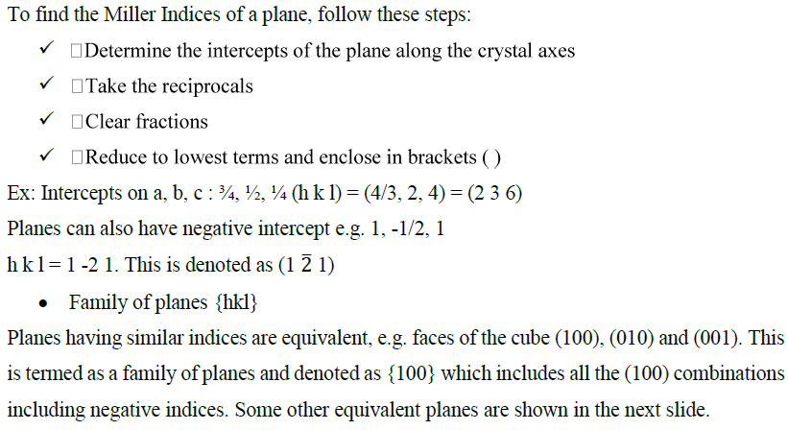

Slide 2
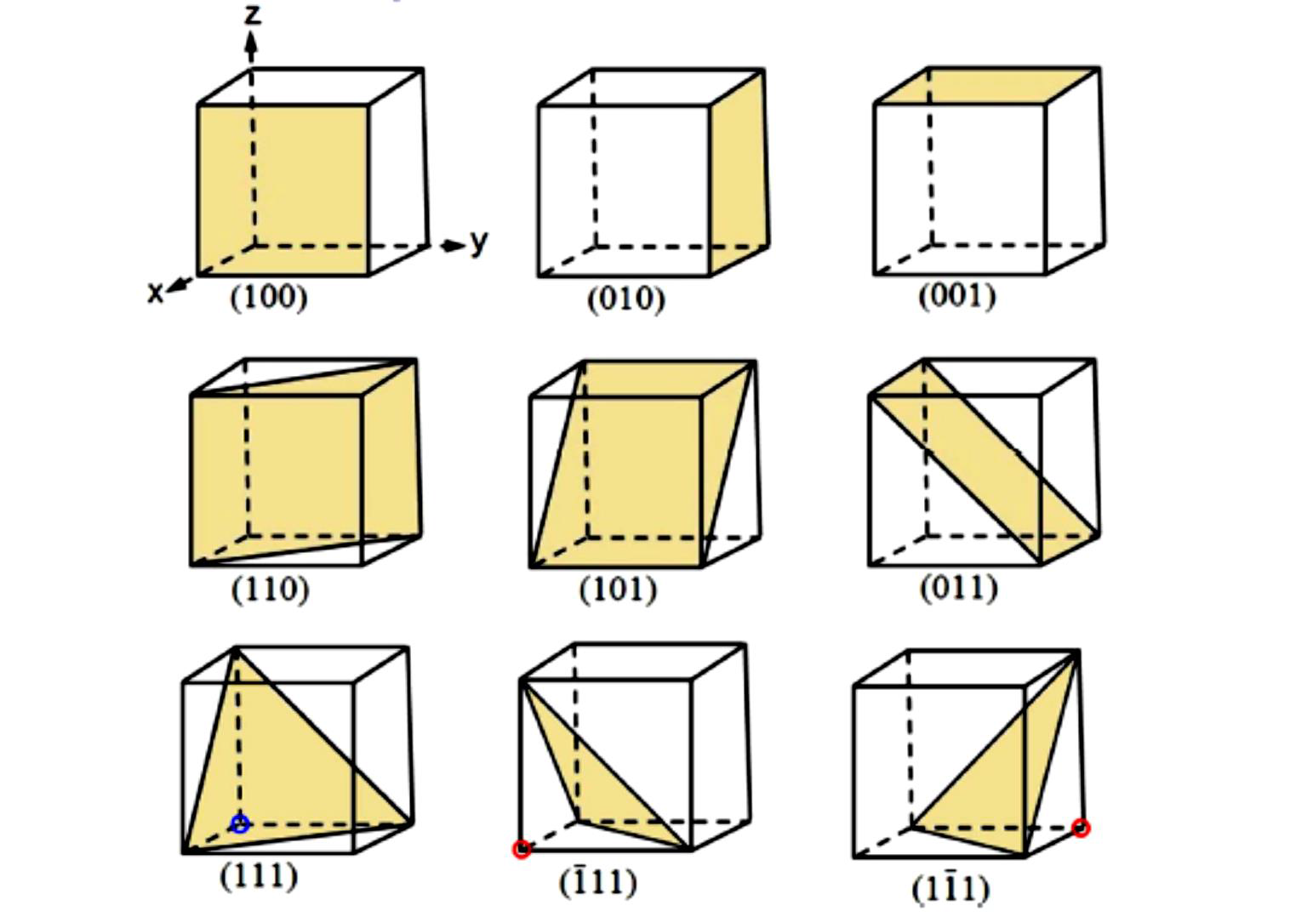
Figure 17 Some other equivalent planes

Slide 3
4. Phase Diagrams (I)
The understanding of phase diagrams for alloy systems is extremely important because there is a strong correlation between microstructure and mechanical properties, and the development of microstructure of an alloy is related to the characteristics of its phase diagram. In addition, phase diagrams provide valuable information about melting, casting, crystallization, and other phenomena.

Slide 4
4.1 Some definition and important terms
Components are pure metals and/or compounds of which an alloy is composed. For example, in a copper–zinc brass, the components are Cu and Z.
System can refer to a specific body of material under consideration (e.g., a ladle of molten steel). Or it may relate to the series of possible alloys consisting of the same components, but
without regard to alloy composition (e.g., the iron–carbon system).
A solid solution consists of atoms of at least two different types; the solute atoms occupy either substitutional or interstitial positions in the solvent lattice, and the crystal structure of the solvent is maintained.

Slide 5
For many alloy systems and at some specific temperature, there is a maximum concentration of solute atoms that may dissolve in the solvent to form a solid solution; this is called a solubility limit. The addition of solute in excess of this solubility limit results in the formation of another solid solution or compound that has a distinctly different composition.
A phase may be defined as a homogeneous portion of a system that has uniform physical and chemical characteristics. Every pure material is considered to be a phase; so also is every solid, liquid, and gaseous solution. For example, the sugar–water syrup solution just discussed is one phase, and solid sugar is another. Each has different physical properties (one is a liquid, the other is a solid); furthermore, each is different chemically (i.e., has a different chemical composition). The solubility limit and phases of sugar in sugar water syrup is shown in Figure 18.

Slide 6
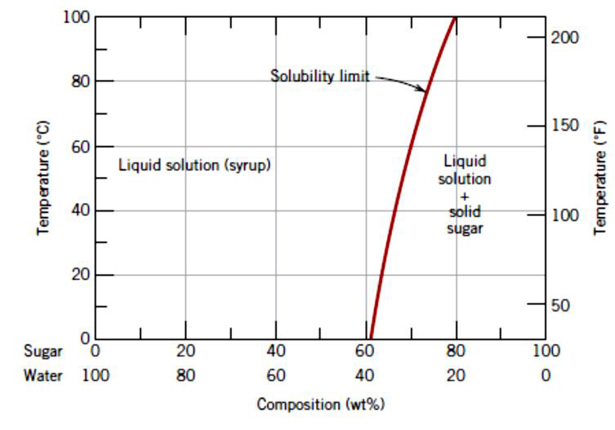
Figure 18 the solubility limit and phases of sugar in sugar water syrup

Slide 7
It is important to note that in metal alloys, microstructure is characterized by the number of phases present, their proportions, and the manner in which they are distributed or arranged. The microstructure of an alloy depends on such variables as the alloying elements present, their concentrations, and the heat treatment of the alloy (i.e., the temperature, the heating time at temperature, and the rate of cooling to room temperature).
A free energy is a function of the internal energy of a system, and also the randomness or disorder of the atoms or molecules (or entropy). A system is at equilibrium if its free energy is at a minimum under some specified combination of temperature, pressure, and composition.
A change in

Slide 8
I t is worth to mention that a change in temperature, pressure, and/or composition for a system in equilibrium will result in an increase in the free energy and in a possible spontaneous change to another state whereby the free energy is lowered.
The term phase equilibrium, often used in the context of this discussion, refers to equilibrium as it applies to systems in which more than one phase may exist.
Phase equilibrium is reflected by a constancy with time in the phase characteristics of a system. Perhaps an example best illustrates this concept is Figure 18. Suppose that a sugar–water syrup is contained in a closed vessel and the solution is in contact with solid sugar at 20o. If the system is at equilibrium, the composition of the syrup is 65 wt% wt% and the amounts and compositions of the syrup and solid sugar will remain constant with time. If the temperature of the system is suddenly raised—say, to 100 Co this equilibrium or balance is temporarily upset in that the solubility limit has been increased to 80 wt%.

